Slide 1
Choosing a ground station

Slide 2
I. Desktop Ground stations: 1)Mission Planner Full featured and widely used GCS. Platform: Windows, Mac OS X (Using Mono)

Slide 3
2)APM Planner 2.0 The best autopilot for use on MAC and Linux platforms. It has a smaller user base and a reduced feature set when compared with Mission Planner.

Slide 4
3)MAVProxy Linux GCS often used by Plane developers. Primarily a command line interface with graphical modules for map and mission editing. Written in Python, and extensible via python modules. Platform: Linux Licence: Open source (GPLv3)

Slide 5
4)UgCS - Universal Ground Control Station Universal and easy to use ground control station with a 3D interface. Supports APM, Pixhawk as well as drones from other manufacturers such as DJI, Mikrokopter and more. Intended for enthusiasts as well as professional users.

Slide 6
4)UgCS - Universal Ground Control Station It is capable of communicating with and controlling multiple drones simultaneously. Platform: Windows, Mac OS X, Ubuntu Licence: Proprietary with a free licence available as well (UgCS Open)

Slide 7
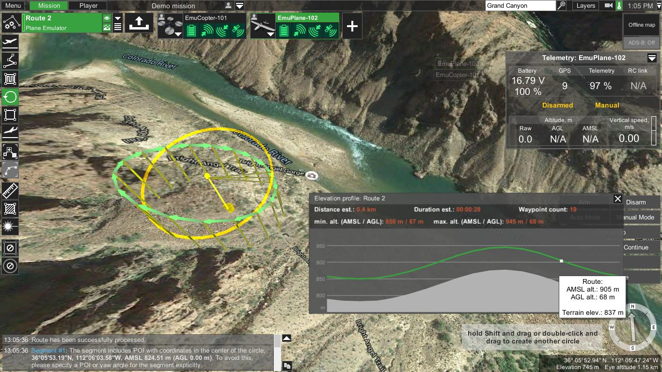

Slide 8
5)QGroundControl QGroundControl work with MAVLink capable autopilots. It’s main focus was originally the PX4 Flight Stack, but it now also comes with complete support for ArduPilot based autopilots. It’s unique among the GCS offerings as it runs on all platforms desktop and mobile. Platform: Windows, Mac OS X, Linux, Android and iOS Licence: Open Source (GPLv3)

Slide 9
II.Comparison Mobile a-android 1)Tower 2)AndroPilot b-ios 1) MAV Pilot 1.4 2) SidePilot

Slide 10
What I suggest?! 1)mission planner: most tutorials on it (arducopter website) 2)Qground control: both windows and android 3)ugcs: advanced

Slide 11
Loading firmware: 1. connect the flight controller using the micro USB cable as shown below. Use a direct USB port on your computer 2- If using the Mission Planner select the COM port drop-down on the upper-right corner of the screen (near the Connect button). Select AUTO or the specific port for your board (PX4FMU or Arduino Mega 2560). Set the Baud rate to 115200 as shown. Don’t hit Connect just yet.

Slide 12
Installing firmware: 1-initial setup: follow wizard but internet is needed 2-click connect and test by tilting the board and watch the HUD

Slide 13
Referance: 1)http://ardupilot.org/copter/docs/common-choosing-a-ground-station.html 2)Review QgroundControl 2.9.4-456 https://www.youtube.com/watch?v=m3OHLOvrdLI 3) NEW Release - UgCS version 2.11 https://www.youtube.com/watch?v=2U1iy9NqRis

